Slide 1
ECE901
Dimitris Papailiopoulos
University of Wisconsin-Madison
Defenses against Adversarial Examples

Slide 2

Robustness of Classification
Robustness:
“The predictions are insensitive to small input perturbations”
Predict(model, ) ≈ Predict(model, )
Are classifiers robust?

Slide 3
Adversarial Noise

Slide 4

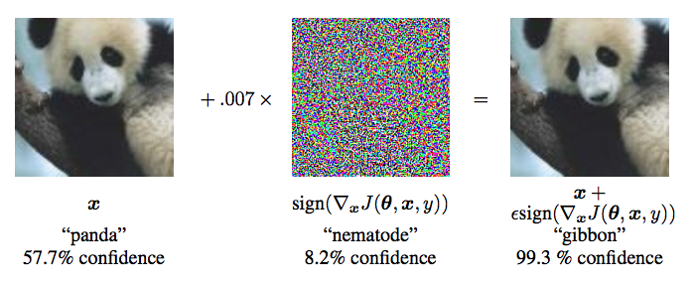
Adversarial Examples
Then, in 2014 something happened…
[Ian J. Goodfellow, Jonathon Shlens & Christian Szegedy, ICLR 2015]

Slide 5
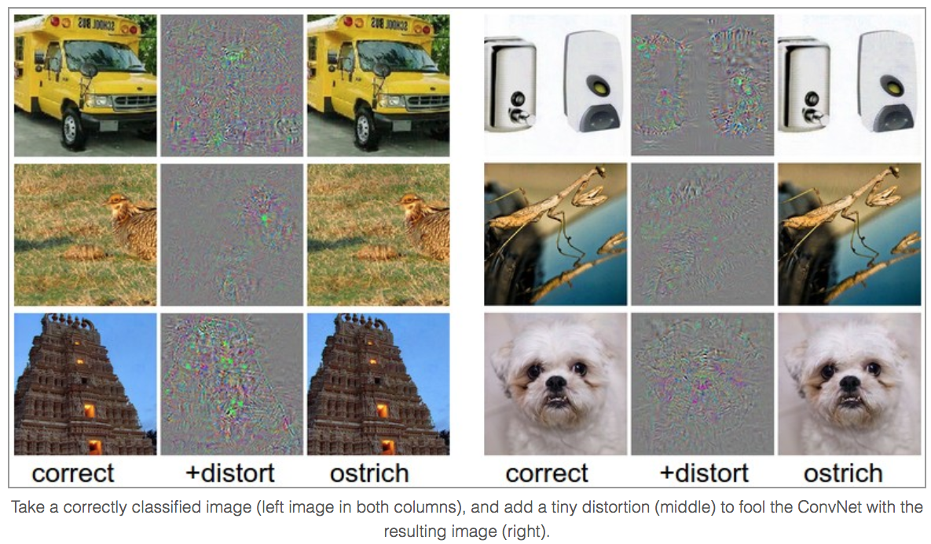
Adversarial Examples
[http://karpathy.github.io/2015/03/30/breaking-convnets/]

Slide 6
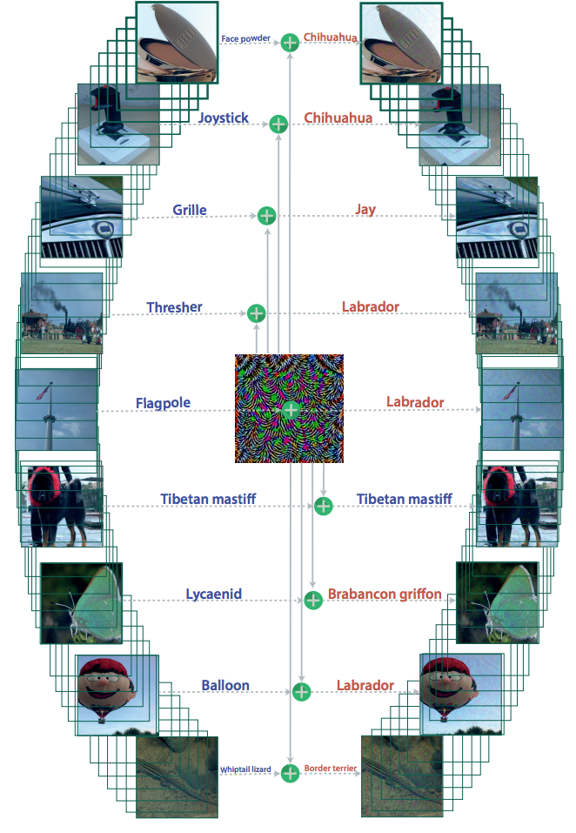
Universal Adversarial Examples
Even image agnostic noise
can break predictions
[Moosavi-Dezfooli, Fawzi,
Fawzi, Frossard, CVPR2017]

Slide 7
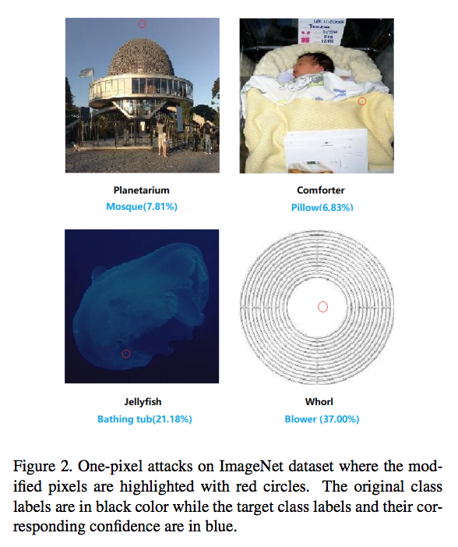
Single Pixel Attacks
[Su, Vargas, Kouichi 2017]

Slide 8
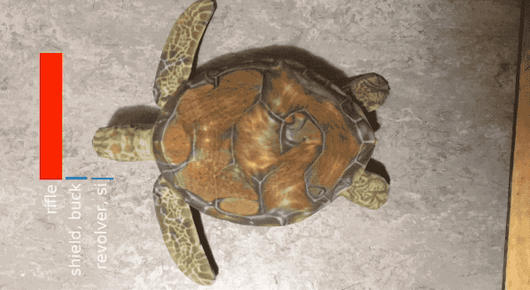
Adversarial Examples in Real Time

Slide 9
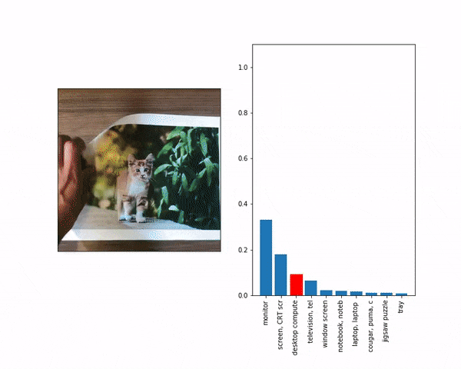
Adversarial Examples in Real Time

Slide 10
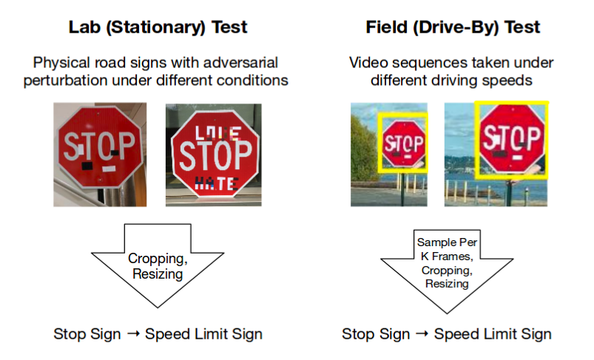
Adv. Example + ML in the wild
Eykholt, Evtimov, Fernandes, Bo Li, Rahmati,
Xiao, Prakash, Kohno, Song. CVPR2018]

Slide 11
Attacking Neural Networks

Slide 12
Robustness of Classification
Adversarial attack: Goal “maximize loss”!
max loss( predict( ); True Label )
st. norm( ) = small
goal
imperceptibility

Slide 13
Threat Model

Slide 14
Threat Models
Simplest and still meaningful: “Black Box:”
just access to predictions
But, a powerful adversary can have access to:
predictions
gradients
model architecture
training data set
Training algorithm + defense mechanism
Compute power
Predict(x)
Input
Output

Slide 15
General Attack Mechanism
Goal for a general learning problem
Taylor’s linear approximation
Linear approx problem
Goal: max this term

Slide 16
Fast Gradient Sign Method
Linear optimization
Usually p = ∞. Optimal perturbation:
FGSM:

Slide 17
Fast Gradient Sign Method
Linear optimization
Usually p = ∞
Iterative FGSM:

Slide 18
Fast Gradient Sign Method
Linear optimization
Usually p = ∞
Iterative targeted FGSM:
FGSM currently one of the fastest and effective attacks

Slide 19
Defense??
Can we design defense mechanisms??
Defense
Predict(x)
Input
Output

Slide 20
Obfuscated Gradients
Shattered Gradients (non-diff.)
Exploding/Vanishing Gradients (making nets too deep)
Stochastic Gradients (input, or network has a bit of noise)
They Don’t Work
[Athalye, Carlini, Wagner, 2018]
Goal: Make Grads “hard” to computer

Slide 21
Data “Cleaning”, or Pre-Processing
Random pixel drops and restorations
Image quilting
Low rank projection
g(x)
Predict(g(x))
Input
Output
They Don’t Work
[Athalye, Carlini, Wagner, 2018]
“Cleaning” function

Slide 22
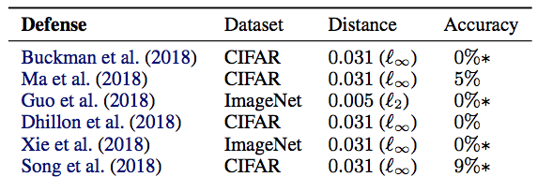
Obfuscated Grads won’t do it
[Athalye, Carlini, Wagner, 2018]

Slide 23
Any good Defense??
Things that kinda work:
“Adversarial Training”
Projecting on the manifold of Images

Slide 24
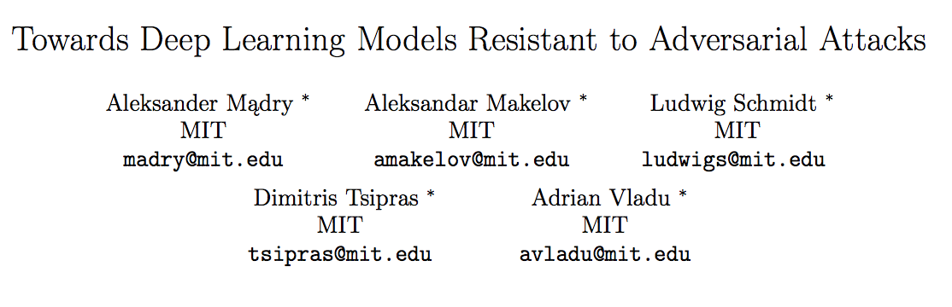
Adversarial Training

Slide 25
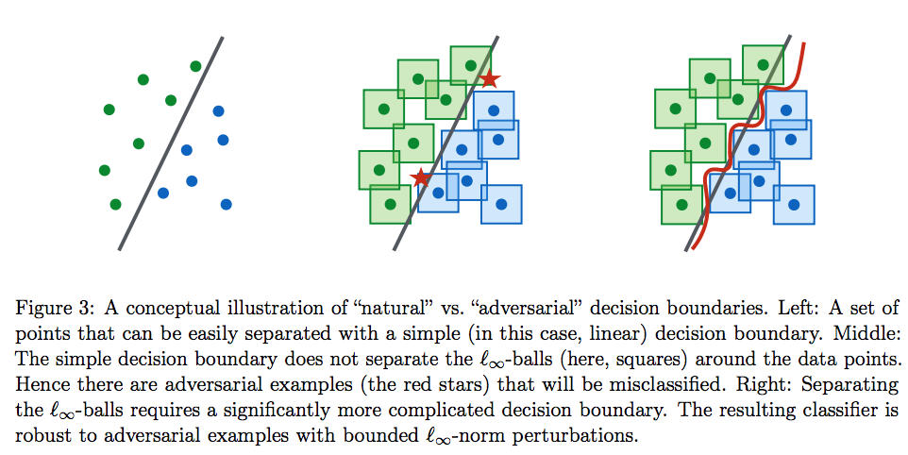

Slide 26
Robust Optimization to the rescue
Goal of the adversary:
How can we “provably” counter it?
Robust ERM
[Huang, Xu, Schuurmans, Szepesvári, 2015]
[Shaham, Yamada, and Negahban 2015]
[Madry, Makelov, Schmidt, Tsipras, Vladu, 2017]

Slide 27
Saddle point
Some thoughts
Nonconvex + nonconcave problems = Really hard!
Generality: Robust ERM oblivious to “type” of attacks.
Looks like the right thing

Slide 28
Saddle point
Is this problem solvable?
Note FGSM
is approximating the inner maximization
Idea: replace training examples, with adversarial examples

Slide 29
Suggested Defense: Adversarial Training
Revisiting the Robust ERM
Q: How to approximately solve? SGD
But what is
Grad of the loss at a maximizer of the inner problem
[Madry, Makelov, Schmidt, Tsipras, Vladu, 2017]

Slide 30
Suggested Defense: Adversarial Training
= Grad of the loss at a maximizer of the inner problem
How to compute that?
Replace input points by their adversarial perturbations and train with SGD
Q: is this a valid thing to do?
[Madry, Makelov, Schmidt, Tsipras, Vladu, 2017]

Slide 31
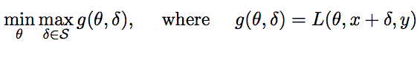
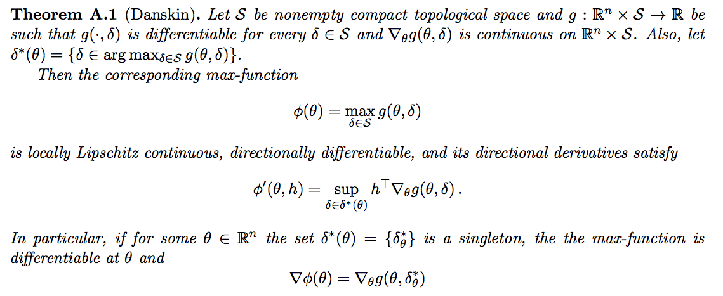
Danskin’s Theorem
Let
[Madry, Makelov, Schmidt, Tsipras, Vladu, 2017]

Slide 32
Suggested Defense: Adversarial Training

Slide 33
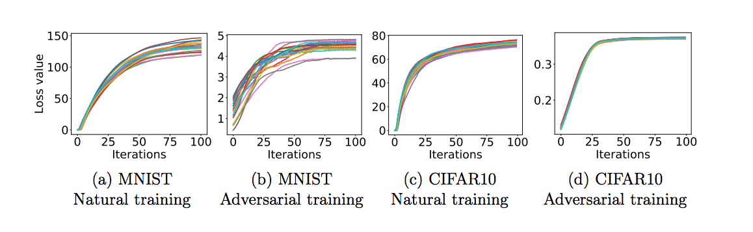
Inner Maximization
Observations:
The loss achieved by the adversary increases in a fairly consistent way and plateaus

Slide 34
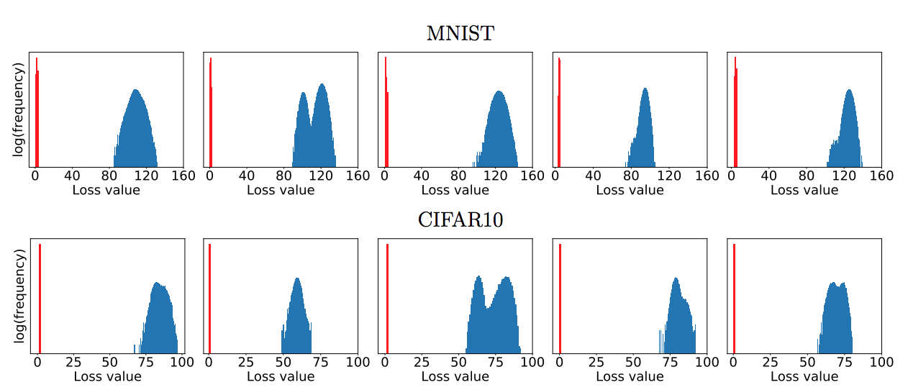
Inner Maximization
Observations:
the loss of the final iterate follows a concentrated distribution

Slide 35
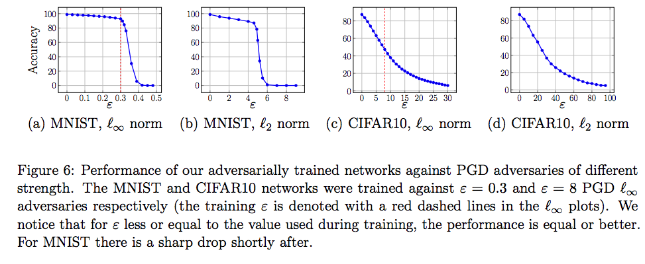
Accuracy

Slide 36
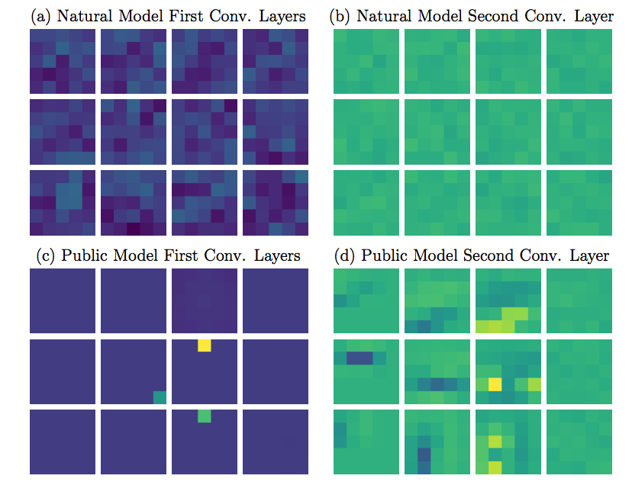
How does the trained filters look?

Slide 37
1st-Order Adversaries
Local maxima found by PGD all have similar loss values
=> robustness against the PGD adversary yields
=> robustness against all first-order adversaries
Conjecture: if we train a network to be robust against PGD adversaries, it becomes robust against a wide range of other attacks as well
If better maxima exist, a lot of random restarts can’t find them
[Madry, Makelov, Schmidt, Tsipras, Vladu, 2017]

Slide 38
Projections on the Manifold of Reality

Slide 39
Here’s an idea
Reality
Adversary moves image slightly outside the realm of reality
Project Back??

Slide 40
Issue: How do we represent Reality?
Reality
GAN
Latent
Space

Slide 41
Here’s an idea
Let’s assume that adversarial examples are “un-natural”
What if we find a “natural” image close to them?
And then Use that to classify
[Madry, Makelov, Schmidt, Tsipras, Vladu, 2017]

Slide 42
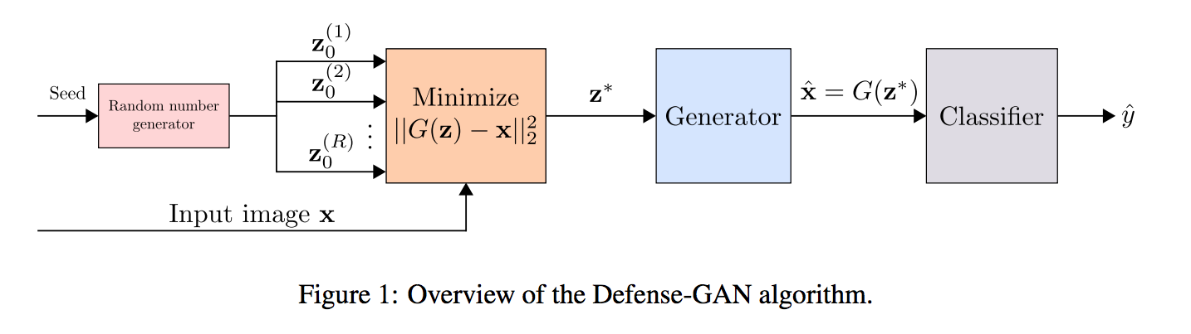
Defenses with GANs
[Samangouei, Kabkab, and Chellappa, ICLR 2018]

Slide 43
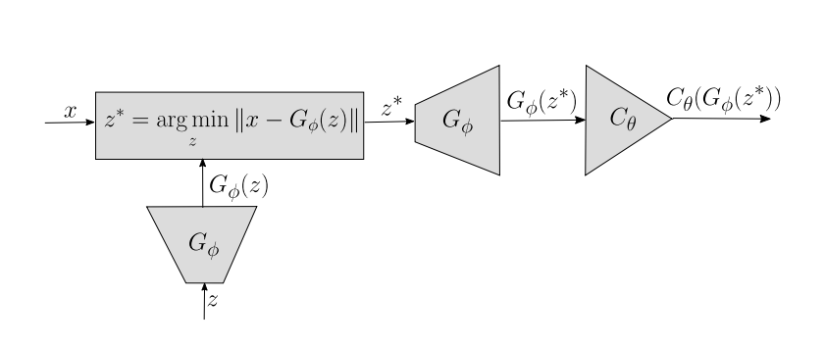
Robust Manifold Defense
Model trained by Adv. Training.
[Ilyas, Jalal, Asteri, Daskalakis, Dimakis, 2018]

Slide 44
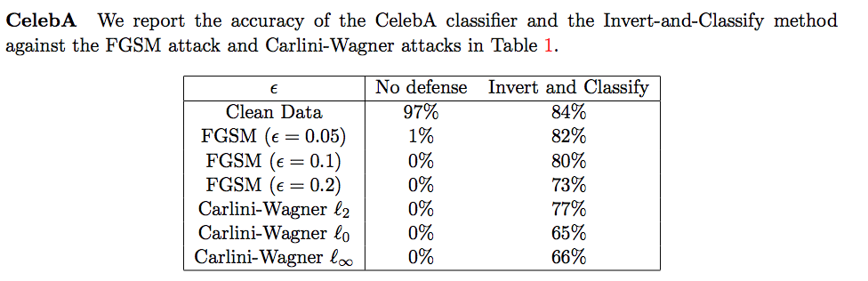
Robust Manifold Defense
[Ilyas, Jalal, Asteri, Daskalakis, Dimakis, 2018]

Slide 45
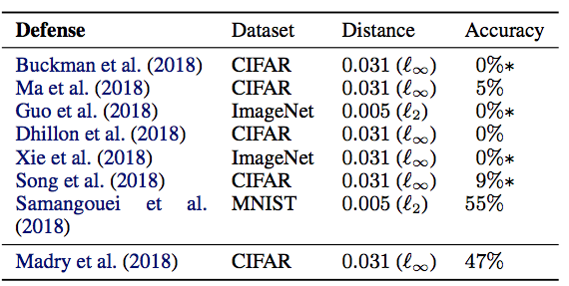
Robust Manifold Defense
Adv. Training and GANS
~50% accuracy

Slide 46
Open Problems
No universally good defense
Robust optimization is slow
Provable (even slow) defenses?
Are Robustness and Learning incompatible?
Are Robustness and poly-number of samples incompatible?
Distributed/Asynchronous Adv. Training?

Slide 47
Robust Training

Slide 48
Stores the model
Gradient Computations

Slide 49
Challenges
beyond communication and stragglers bottlenecks

Slide 50
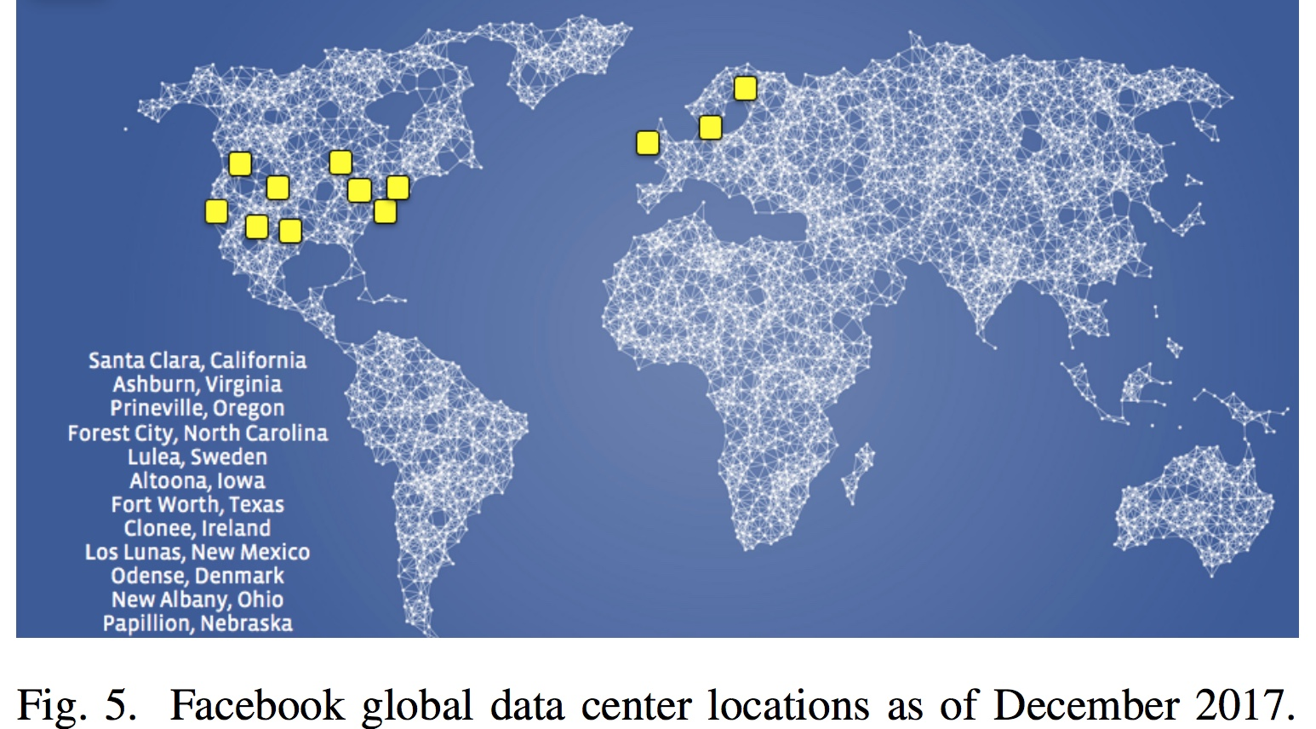
Robustness: a key Challenge
“For […] training and inference […] the importance of disaster-readiness cannot be underestimated.”
“Adversaries are constantly searching for new […] ways to bypass our identifiers […]”
Applied Machine Learning at Facebook: A Datacenter Infrastructure Perspective [fb, HPCA2018]

Slide 51
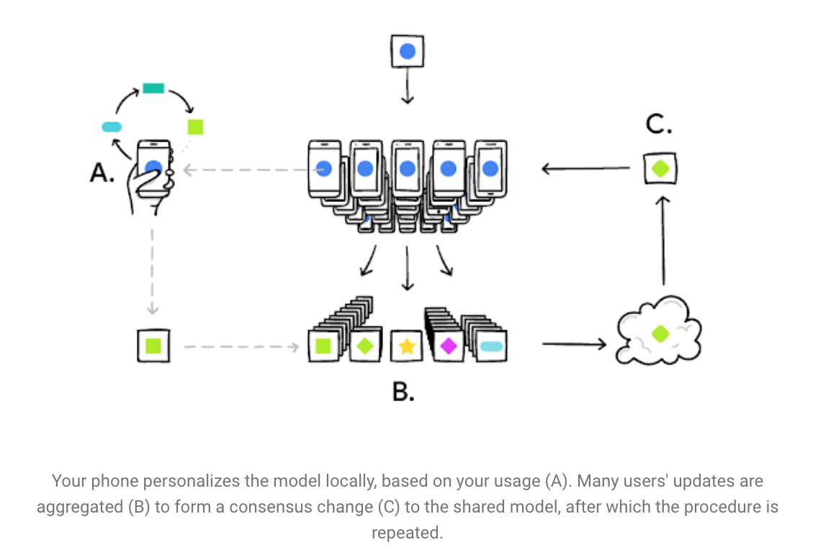
Robustness: a key Challenge
What if Adversarial?

